Slide 1
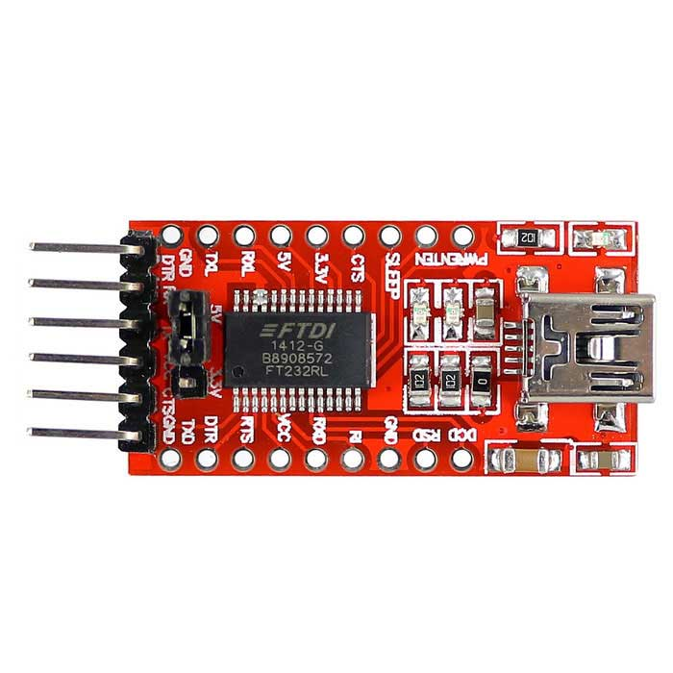
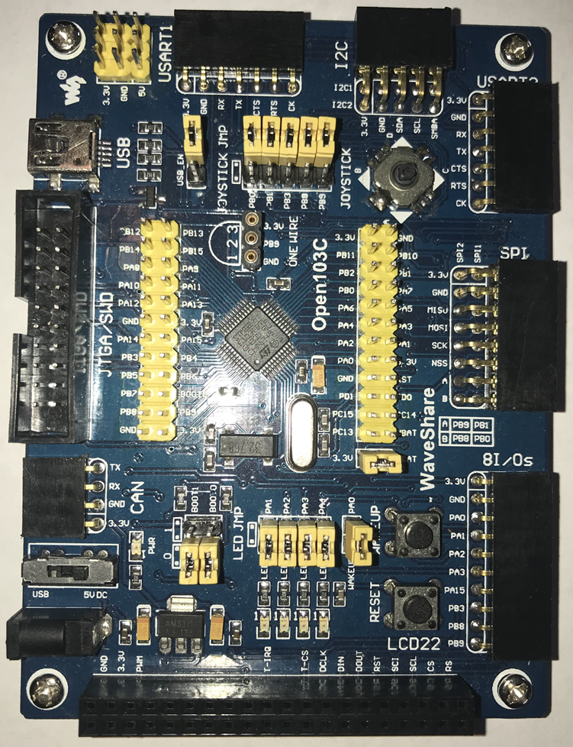
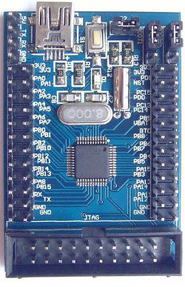
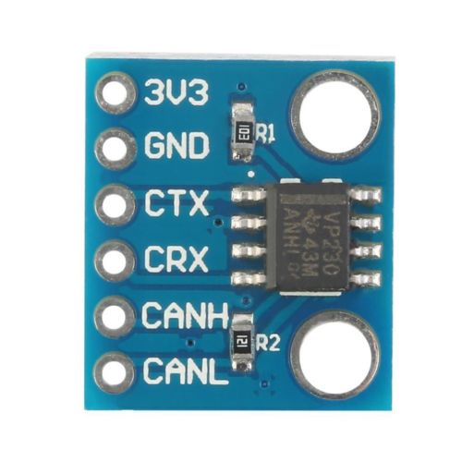
FT232RL USB to USART
+5V Power
SLCAN Adapter
uc4h-slcan-v007-pcb-v1x-f103t8c8cb.hex
PB6 = A1
PB7 = A2
PB0 = B1
PB1 = B2
PA0 = C1
PA1 = C2
GND
GND
CTS
VCC
TX
RX
DTR
ESC/ACT Node
uc4h-bootloader-v002.hex
uc4h-escactuator-v014-node-v1x-f103t8c8cb-wobl.hex
<- RX USB-TTL
CANH
TX USB-TTL ->
CANL
CANRX
CANTX
GND
+3.3V Power
PA11 (GRN) = CANRX
PA12 (YEL) = CANTX
PA9 (BRN) = UART1_TX -> RX USB-TTL
PA10 (GRY) = UART1_RX -> TX USB-TTL

Slide 2
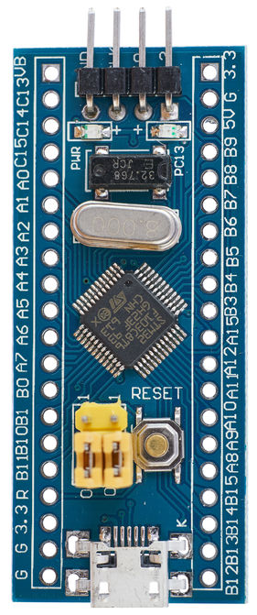
PB6 = A1
PB7 = A2
PB0 = B1
PB1 = B2
PA0 = C1
PA1 = C2
FT232RL USB to USART
+5V Power
SLCAN Adapter
uc4h-slcan-v007-pcb-v1x-f103t8c8cb.hex
GND
GND
CTS
VCC
TX
RX
DTR
<- RX USB-TTL
CANH
TX USB-TTL ->
CANL
CANRX
CANTX
GND
+3.3V Power
PA11 (GRN) = CANRX
PA12 (YEL) = CANTX
PA9 (BRN) = UART1_TX -> RX USB-TTL
PA10 (GRY) = UART1_RX -> TX USB-TTL
ESC/ACT Node
uc4h-bootloader-v002.hex
uc4h-escactuator-v014-node-v1x-f103t8c8cb-wobl.hex

Slide 3
PB6 = A1
PB7 = A2
PB0 = B1
PB1 = B2
PA0 = C1
PA1 = C2
FT232RL USB to USART
+5V Power
SLCAN Adapter
uc4h-slcan-v007-pcb-v1x-f103t8c8cb.hex
GND
GND
CTS
VCC
TX
RX
DTR
<- RX USB-TTL
CANH
TX USB-TTL ->
CANL
CANRX
CANTX
GND
+3.3V Power
PA11 (GRN) = CANRX
PA12 (YEL) = CANTX
PA9 (BRN) = UART1_TX -> RX USB-TTL
PA10 (GRY) = UART1_RX -> TX USB-TTL
ESC/ACT Node
uc4h-bootloader-v002.hex
uc4h-escactuator-v014-node-v1x-f103t8c8cb-wobl.hex

Slide 4
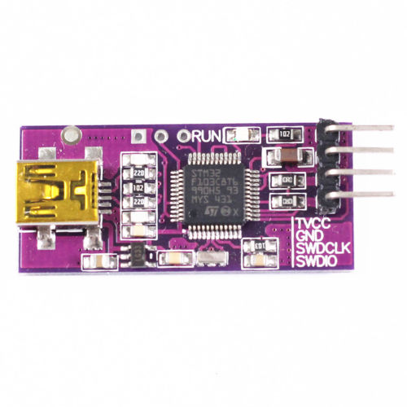
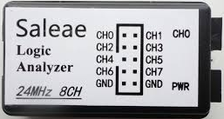
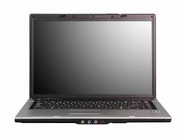
PB6 = A1
PB7 = A2
PB0 = B1
PB1 = B2
PA0 = C1
PA1 = C2
ARM SWD DEBUGGER
FT232RL USB to USART
+5V Power
GND
GND
CTS
SWDIO
VCC
SLCAN Adapter
uc4h-slcan-v007-pcb-v1x-f103t8c8cb.hex
SWCLK
TX
GND
RX
Vcc
DTR
<--
-->
PA11 (GRN) = CANRX
PA12 (YEL) = CANTX
PA9 (BRN) = UART1_TX -> RX USB-TTL
PA10 (GRY) = UART1_RX <- TX USB-TTL
CANH
CANL
REMOVE
CANRX
CANTX
GND
+3.3V Power
CANRX
USB
ESC/ACT Node
uc4h-bootloader-v002.hex
uc4h-escactuator-v014-node-v1x-f103t8c8cb-wobl.hex
CAN Bus Sniffer

Slide 5
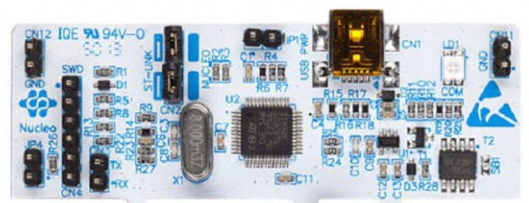
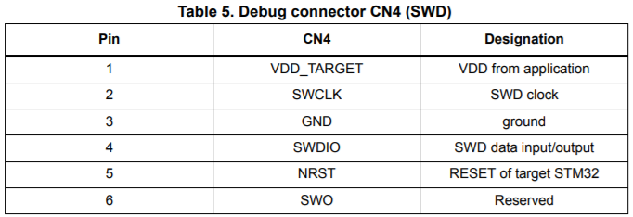
PB6 = A1
PB7 = A2
PB0 = B1
PB1 = B2
PA0 = C1
PA1 = C2
FT232RL USB to USART
+5V Power
GND
GND
CTS
VCC
SLCAN Adapter
uc4h-slcan-v007-pcb-v1x-f103t8c8cb.hex
TX
RX
DTR
<--
-->
PA11 (GRN) = CANRX
PA12 (YEL) = CANTX
PA9 (BRN) = UART1_TX -> RX USB-TTL
PA10 (GRY) = UART1_RX <- TX USB-TTL
CANH
CANL
CANRX
CANTX
GND
+3.3V Power
ARM SWD DEBUGGER
FreeRTOS Node
UAVCAN_NODE_FreeRTOS.hex

Slide 6
PB6 = A1
PB7 = A2
PB0 = B1
PB1 = B2
PA0 = C1
PA1 = C2
FT232RL USB to USART
+5V Power
GND
GND
CTS
VCC
SLCAN Adapter
uc4h-slcan-v009.hex
TX
RX
DTR
<--
-->
PA11 (GRN) = CANRX
PA12 (YEL) = CANTX
PA9 (BRN) = UART1_TX -> RX USB-TTL
PA10 (GRY) = UART1_RX <- TX USB-TTL
CANH
CANL
CANRX
CANTX
GND
+3.3V Power
ARM SWD DEBUGGER
Arduino UAVCAN Node
libcanard_example.ino

Slide 7
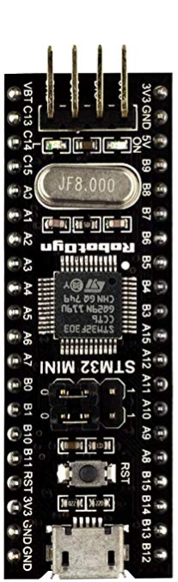
PB6 = A1
PB7 = A2
PB0 = B1
PB1 = B2
PA0 = C1
PA1 = C2
FT232RL USB to USART
+5V Power
GND
GND
CTS
VCC
SLCAN Adapter
uc4h-slcan-v009.hex
TX
RX
DTR
<--
-->
PA11 (GRN) = CANRX
PA12 (YEL) = CANTX
PA9 (BRN) = UART1_TX -> RX USB-TTL
PA10 (GRY) = UART1_RX <- TX USB-TTL
CANH
CANL
CANRX
CANTX
GND
+3.3V Power
ARM SWD DEBUGGER
Arduino UAVCAN Node
libcanard_example.ino

Slide 8
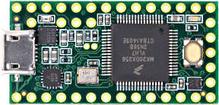
PB6 = A1
PB7 = A2
PB0 = B1
PB1 = B2
PA0 = C1
PA1 = C2
FT232RL USB to USART
+5V Power
GND
GND
CTS
VCC
TX
TX USB-TTL ->
RX
<- RX USB-TTL
DTR
CANH
CANL
CANRX
CANTX
Teensy 3.x CAN Adapter
uc4h-slcan-v007-pcb-v1x-f103t8c8cb.hex
GND
+3.3V Power
ESC/ACT Node
uc4h-bootloader-v002.hex
uc4h-escactuator-v014-node-v1x-f103t8c8cb-wobl.hex
PA11 (GRN) = CANRX
PA12 (YEL) = CANTX
PA9 (BRN) = UART1_TX -> RX USB-TTL
PA10 (GRY) = UART1_RX -> TX USB-TTL

Slide 9
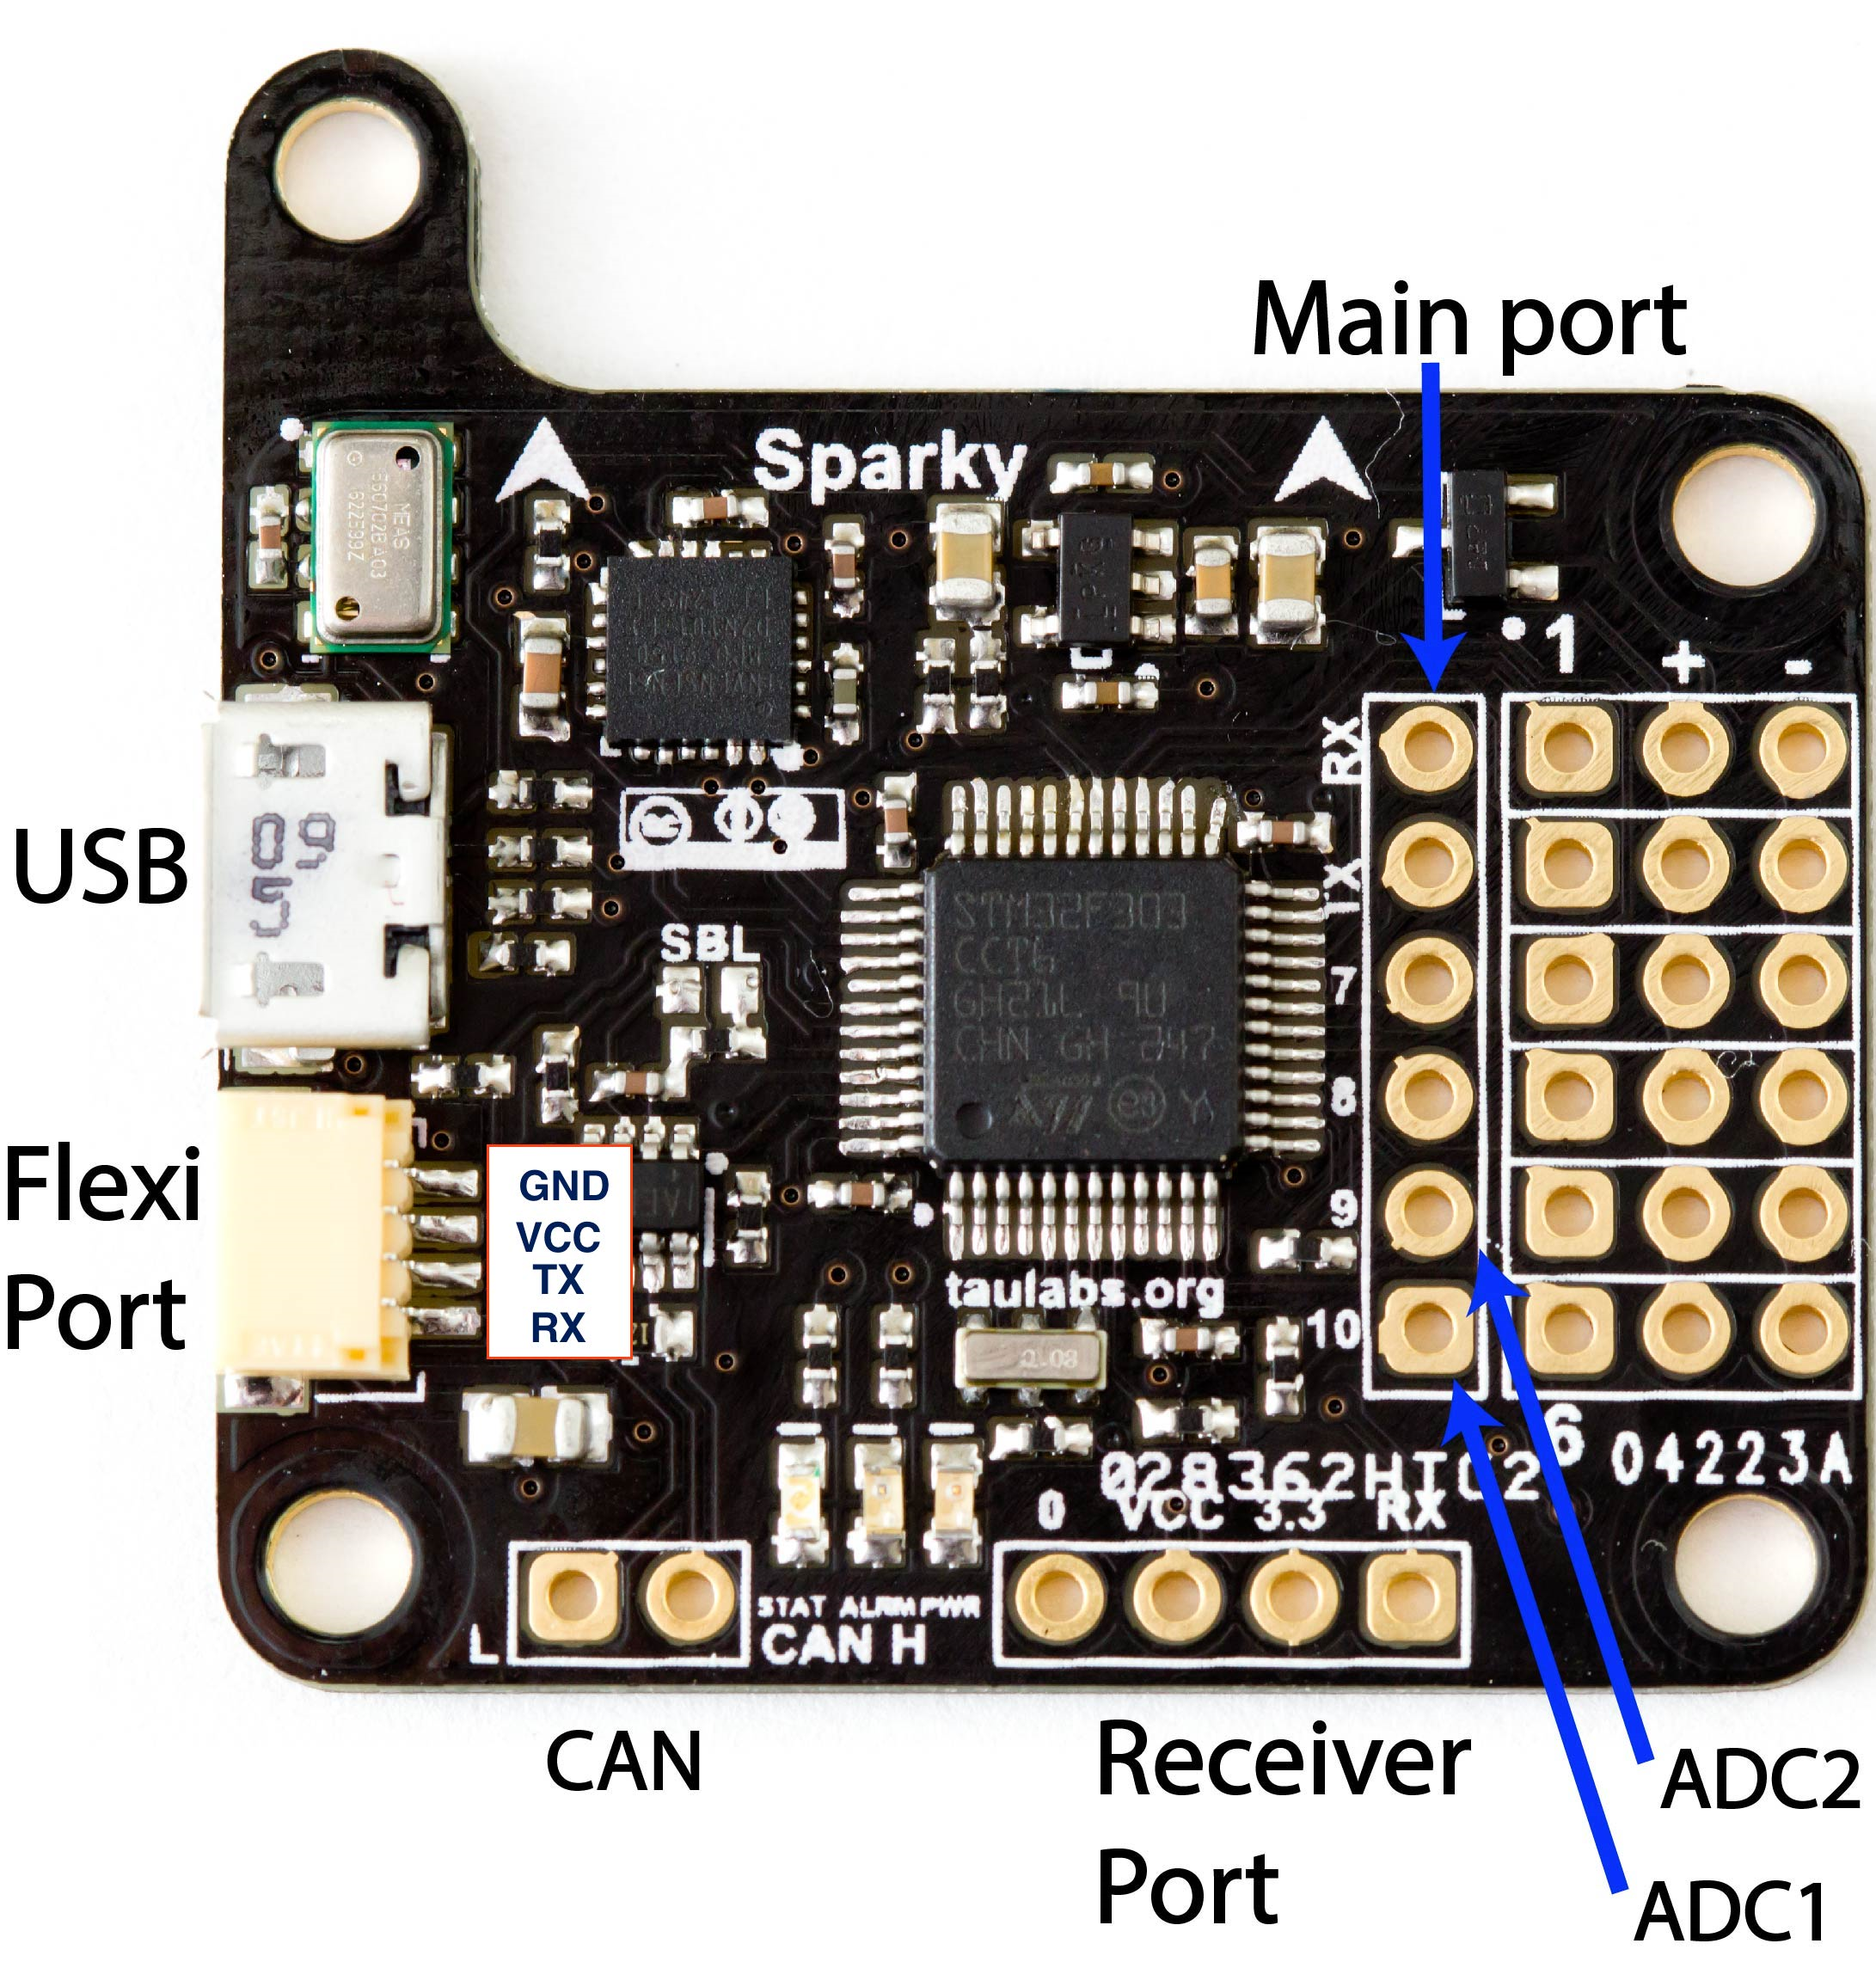
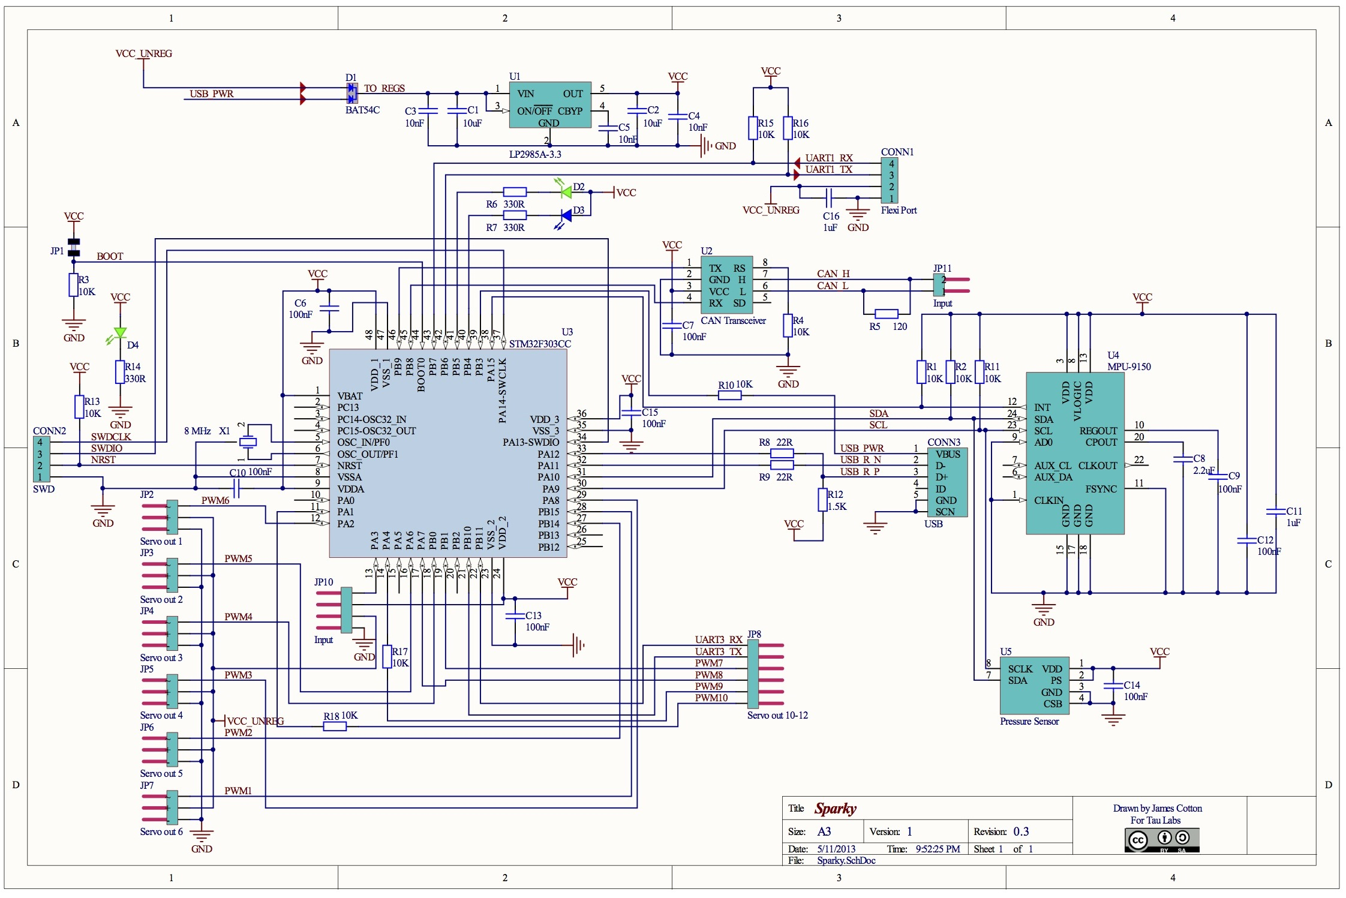
Processor: STM32F303CCT6
PB11:D31
PB10:D30
PB1:D29:A9
PA7:D27:A7
PA4:D24:A4
PA1:D21:A1
PB15:D13
PB14:D14
PA8:D12
PB0:D28:A8
PA6:D26:A6
PA2:D22:A2
PB4:D5 RED
PB5:D4 BLU
Pwr GRN
LED
GND
VCC
PB6:D3
PB7:D2
CAN
LO HI
D23:A3
PA3

Slide 10
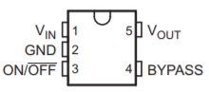

Slide 11
BACKUP MATERIAL

Slide 12
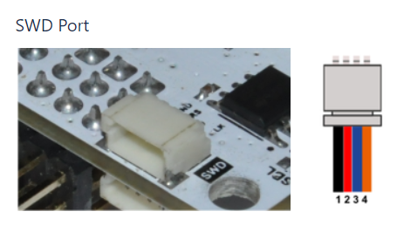
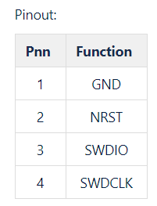
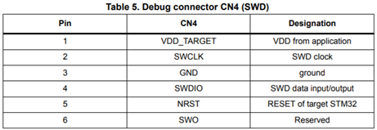

Slide 13
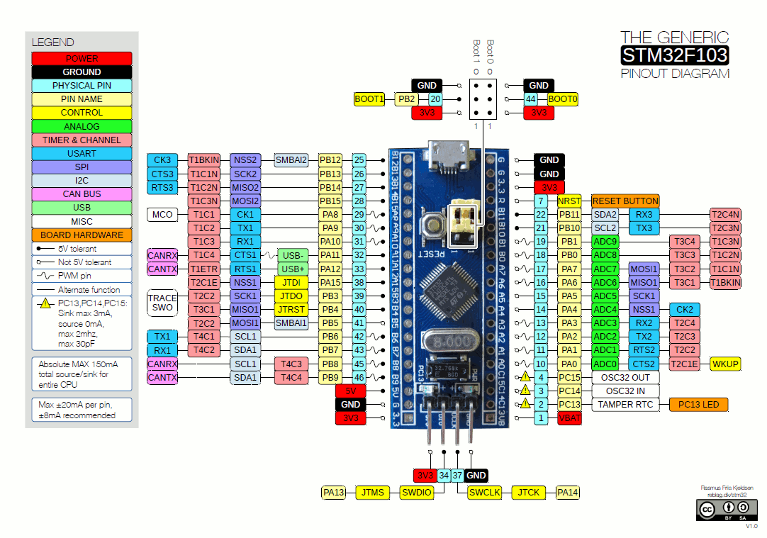

Slide 14
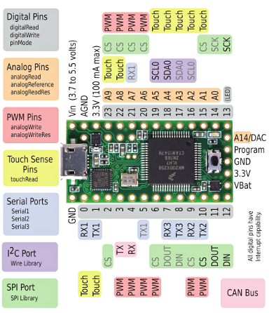
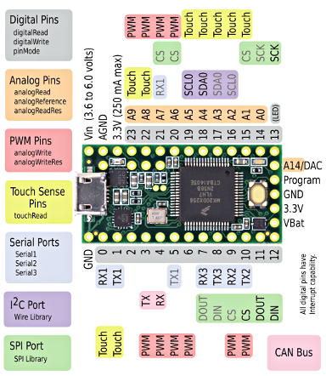

Slide 15
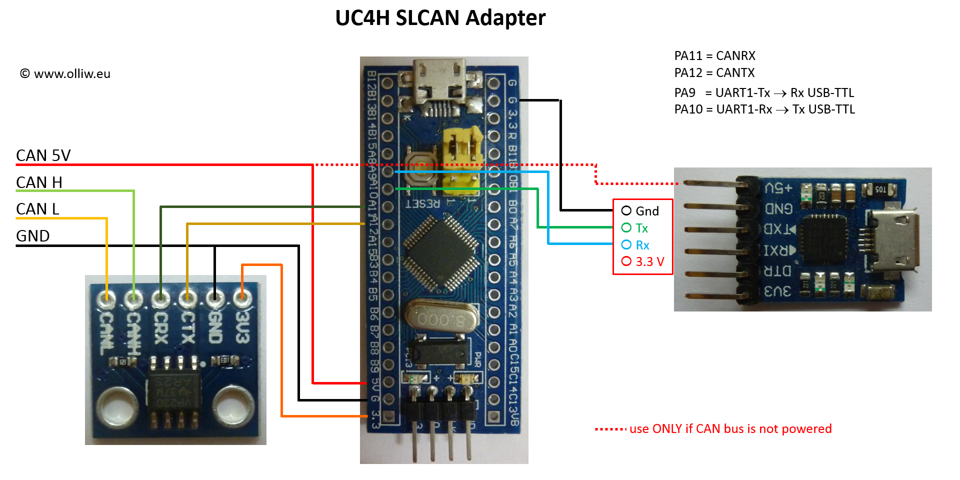

Slide 16
